Slide 1
E-Auction System
Team Members
Binod Bastakoti
Nuhendra Kumar Giri
Rajan Prrasad Upadhaya
Professor: Joe Bruen

Slide 2
Objectives
To learn and effectively implement spring web MVC technology.
To Learn and implement N-tier architecture using various spring MVC web component .
To become a team player learning work culture inside a team.
To use and enhance science of creative intelligence in a work environment.

Slide 3
Background
Ecommerce is getting more and more attention from entrepreneur and consumers, both local and international.
Auction site is one of them which has recently emerged and is very popular among the internet users.

Slide 4
Auction
Auction is the process of selling goods such that buyers and sellers communicate to each other so as to get the best deal.
In auction no item has fixed price. The fixed price depends upon bid amount.

Slide 5
E-Auction System
User can search for the available auctions.
User can login and choose between either creating an auction or to bid on available auction.
User can view bids successfully made and wish lists.

Slide 6
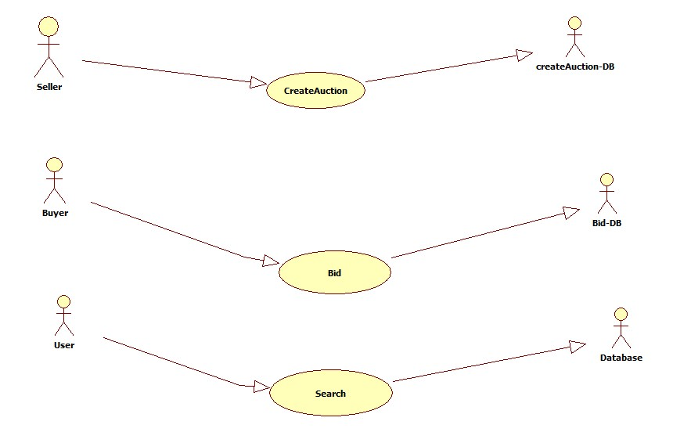
Use case Diagram

Slide 7
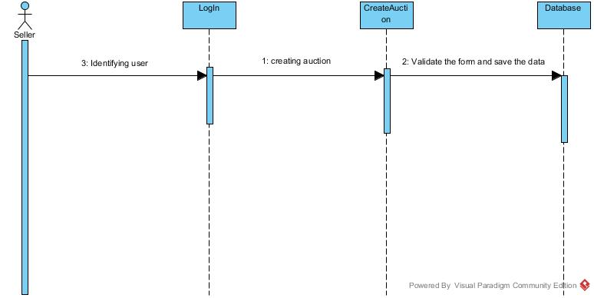
Sequence Diagram for Create Auction

Slide 8
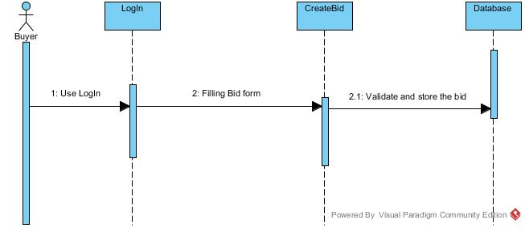
Sequence Diagram for Bid

Slide 9
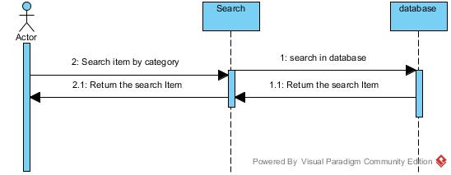
Sequence Diagram for Search

Slide 10
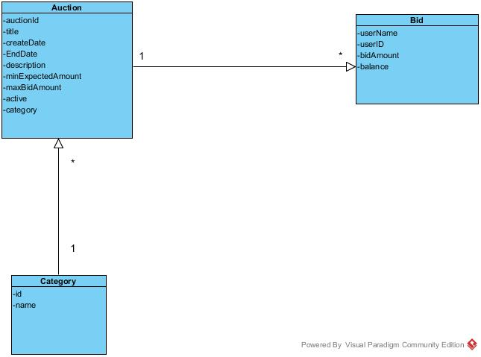
Class Diagram

Slide 12
Demo Demonstration
Thank You

